Slide 1
LANE-697
Special Topics in Linguistics
Forensic Linguistics
Abdulrahman S. Aljabri
2nd semester 2019

Slide 2
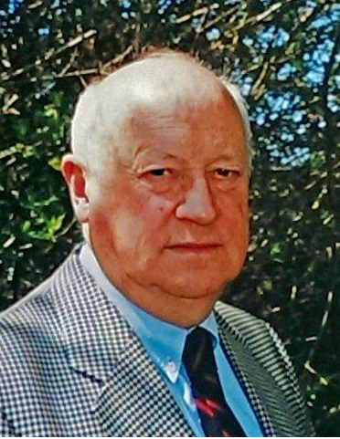
What is Forensic linguistics?
Is the scientific study of language as applied to forensic purposes and contexts.
These purposes include the written language of the law, spoken interaction in legal settings and language as evidence.
Jan Svartvik coined the term ‘’forensic linguistics’ 1968

Slide 3
Legal evidence
Plagiarism detection
Disputed meaning
Forensic phonetics
Author identification
Forensic Linguistics

Slide 4
Legal evidence
In the last three decades, forensic linguists have been involved in providing legal evidence in court to condemn or release suspects on several topics, such as:
Trademarks, Speaker identification, country of origin, the linguist competence of non-native suspects, the authorship of text messages, emails, tweets, suicide notes wills, etc.

Slide 5
Author Identification
Also known as Forensic stylistics (or stylometry)
Forensic authorship analysis:
Is an interdisciplinary field between linguistics and law where linguists analyze written texts in order to uncover the distinctive linguistic features of an author’s style.
It is believed that individuals vary in their use of language in both, oral and written form.

Slide 6

During this process, linguists are asked to do one of two things depending on the situation.
a- Sociolinguistic profiling
b- authorship attribution
Sociolinguist profiling is used when for example, the police have weak hypotheses about the identity of the author(s).

Slide 7
Linguists task is to look for sociolinguistic clues that may highlight the identity of the writer, such as age, gender, social and regional background. (Tony Blair)
Authorship attribution is usually requested when the situation is more complicated with more than one text and more than one potential authors.
It focuses on the linguistic patterning of all levels, including syntax, lexicogrammar, discourse, orthography, punctuation and layout. In addition, it recently included ICT mediated communications as with emojis and initialisms.

Slide 8
These linguistic features establish the distinctive idiosyncrasies of the individual author on which any authorship is based.
The process is usually a comparison of an unknown and a set of texts written by the suspects.
However, with the recent trend of 2.0 technologies, such as Facebook, what's App and Twitter, the task of forensic linguists has become even more complicated.
The shorter the text, the less unique information it contains.

Slide 9
Forensic linguistic analysis benefits from the contribution of other scientific fields, such as statistics and computational linguistics.
They facilitate the task of forensic linguists by helping in conducting the quantitative analysis of large amount of data.
Regarding which features should the analysis cover, some features are universal while others are language-specific. These features are usually word frequency and repetition of significant short sequences of letters or words.

Slide 10
Plagiarism detection
Another area where linguists scored success in is the detection of plagiarism. It is not only applied to academic plagiarism, but it extends to include miscarriages of justice.
Detecting plagiarism within the same language has become relatively easy and straightforward.
However, detecting translingual plagiarism ( texts which are reused in another language) is more complicated because a direct comparison is not possible in such cases. Linguists translate the suspected text into the potential language of the original and then, look up matches on the internet.

Slide 11
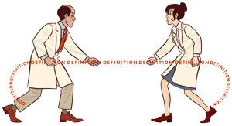
Disputed meaning
Another task that forensic linguists contribute to is the provision of evidence of disputed meaning.
Linguists have been involved in clarifying meanings in legal constructs in order to help courts to draw clear-cut distinctions of what constitutes for example libel, slander or defamation.

Slide 12
Also, when suspects are deliberately using non-standard or encrypted language to disguise the nature of some crime.
They are also involved in assessing the linguistic similarity and confusability of trademarks.
Forensic linguistic evidence has also been utilized in online crimes, such as hate crimes, threats, fraud, identity theft, electronic vandalism and violation of intellectual property rights.

Slide 13
Forensic phonetics
Forensic phonetics has evolved separately from Forensic Linguistics .
It is used to analyze audio recordings for two purposes:
1- to establish what was actually said (transcription).
2- who is the speaker. (voiceprint)

Slide 14
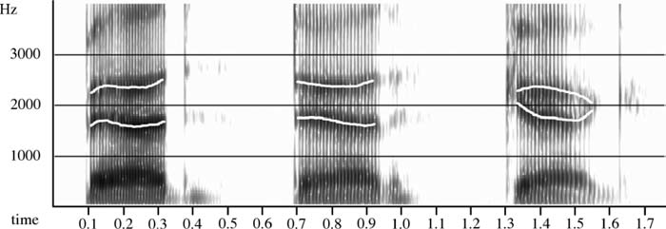
Through using Spectrograms, phoneticians are able to distinguish individual variation in speech habits rather than the speaker’s language which reflect the individual physiological characteristics of the speaker. e.g. length and type of aspiration.

Slide 15
The future of forensic linguistics is with no doubt promising and extremely important, especially with the rapid technological advancements that arise new challenges to which forensic linguistics have to encounter.

Slide 16
References
Ladefoged, Peter and K. Johnson (2011). A Course in Phonetics. 6th Edition . Wadsworth: Cengage Learning.
McMenamin, G. R. (2002) Forensic Linguistics: Advances in Forensic Stylistics. CRC Press LLC.
Olsson, J. (2008) Forensic Linguistics, 2nd ed. Continuum International Publishing Group, London.
Ariani, M. G., Sajedi, F. and Sajedi, M. (2014) Foresnsic linguistics: A brief overview of the key elements. Procedia – Social and Behavioral Sciences 185 (2014) 222-225.
Coulthard, M., Grant, T. & Kredens, K. (2009) Forensic linguistics. 10.4135/9781446200957.n35.
Coulthard, M. Sousa-Silva, R. (2016) Forensic Linguistics. n book: What are Forensic Sciences?: Concepts, Scope and Future Perspectives, Chapter: 18, Publisher: Pactor, Editors: Ricardo J. Dinis-Oliveira, Teresa Magalhães.

Slide 17
What Is Forensic Linguistics? (n.d.) [Web page] Retrieved from https://www.careerigniter.com/questions/what-is-forensic-linguistics/
Wikipedia contributors. (2018, December 31). Forensic linguistics. In Wikipedia, The Free Encyclopedia. Retrieved 23:18, January 19, 2019,from https://en.wikipedia.org/w/index.php?title=Forensic_linguistics&oldid=876166320
[Image] Jan Svartvik PhD. Retrieved from https://tale-forensiclinguistics.org/honorary-fellows/jan-svartvik-phd/
[Image] Words on Trial, (Hitt, J.) Retrieved from https://www.newyorker.com/magazine/2012/07/23/words-on-trial
[Image] Anonymous person. Retrieved from http://chittagongit.com/icon/anonymous-person-icon-23.html
[Image] Language: disputed definitions. Retrieved from https://www.nature.com/news/2008/081022/full/4551023a.html
[Diagram] Figure 8.8 Spectrograms of the forms [ pʰԑm ], [ tʰԑn ] (ten), and [ kʰԑN ]. Retrieved from Ladefoged, Peter and K. Johnson (2011). A Course in Phonetics. 6th Edition . Wadsworth: Cengage Learning (p 200).

Slide 18
The End
Thank You

